Slide 1
DATA ANALYSTIC IMAGES
USING JUPYTER LAB TO GET THE DASHBOEARD OF SALEBD
REVENU BY CITY
REVENU BY PRODUCT
REVENU BY ORDERDATE (DAILY)
TOP 5 CUSTOMER REVENU
CUSTOMERS SPENDING BY CITY

Slide 2
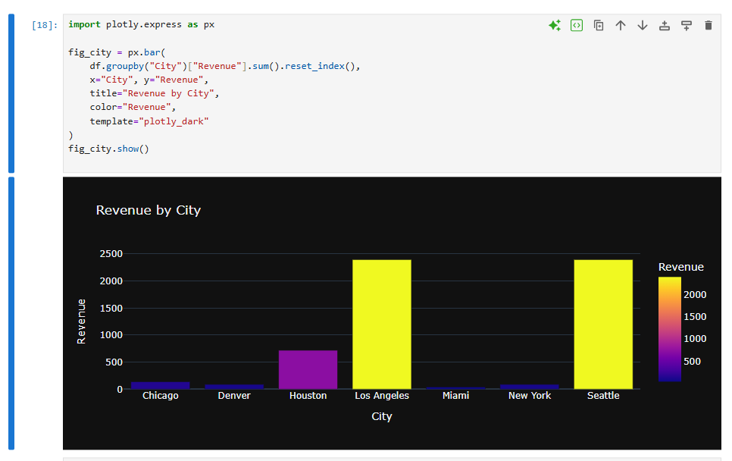
REVENU BY CITY

Slide 3
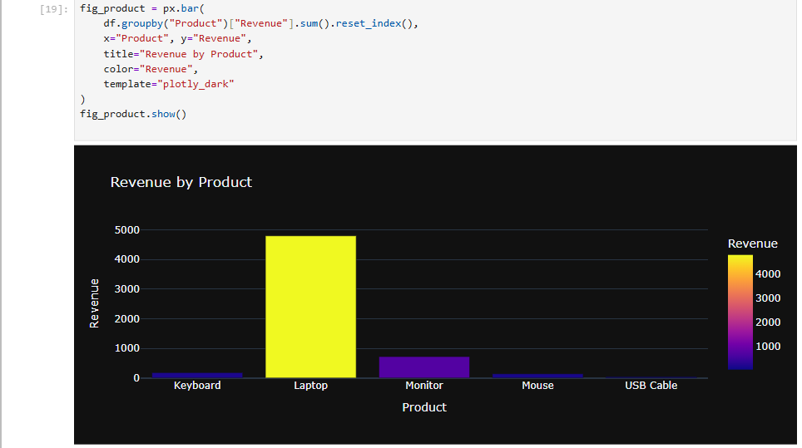
REVENU BY PRODUCT

Slide 4
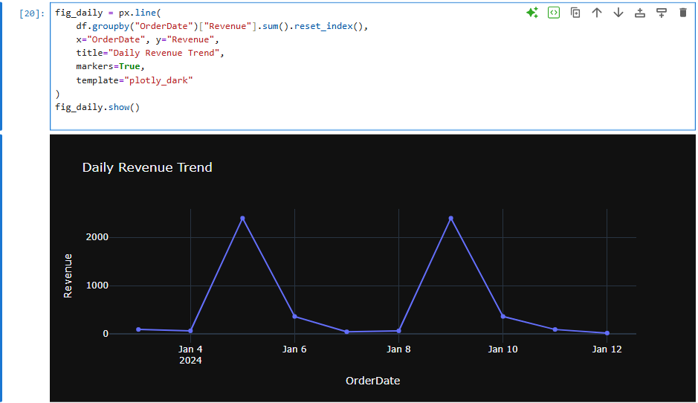
REVENU BY ORDERDATE (DAILY)

Slide 5
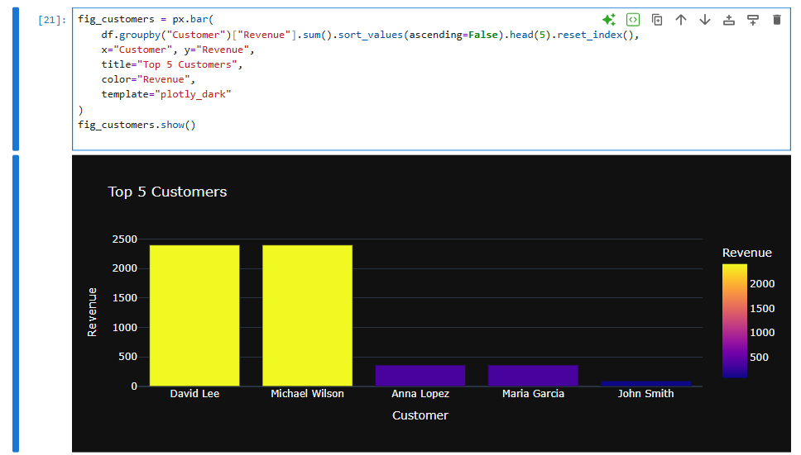
TOP 5 CUSTOMER REVENU

Slide 6
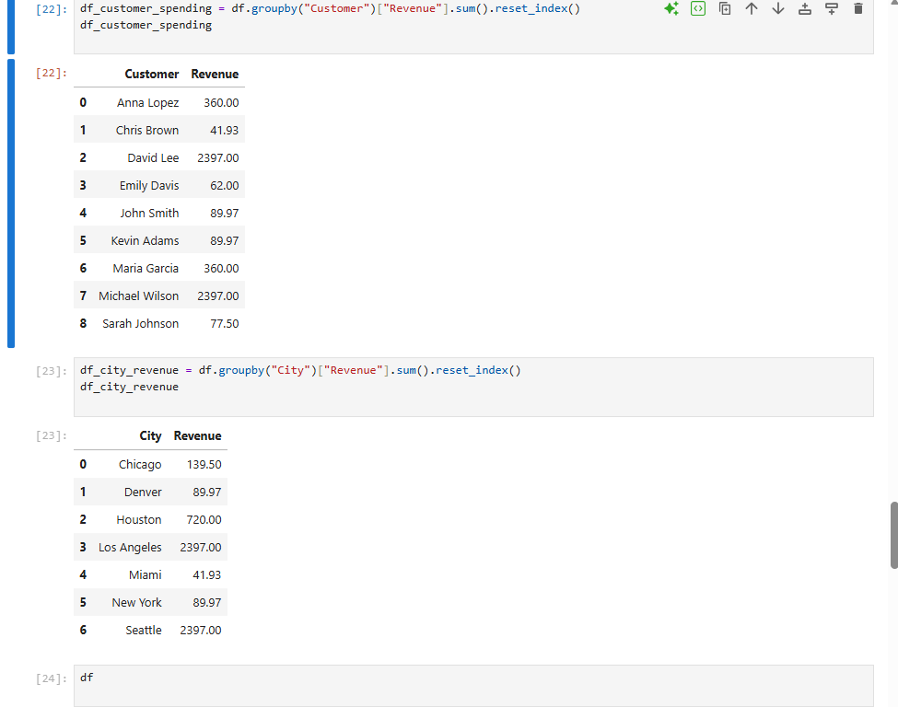
CUSTOMERS SPENDING BY CITY

